Slide 1
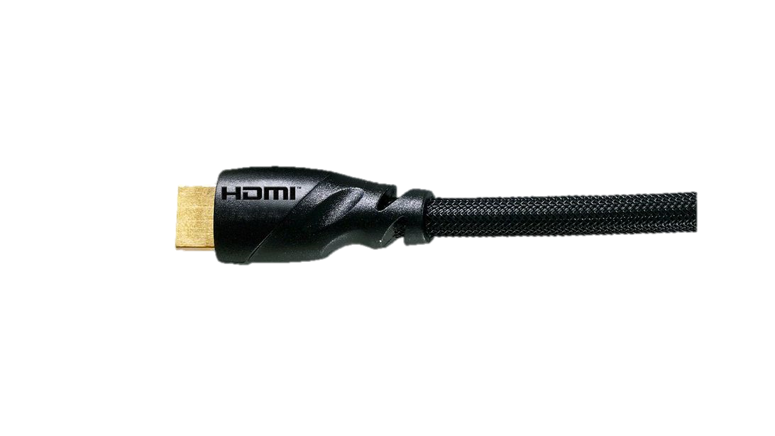
HDMI 2.1
High Definition Multimedia Interface 高清晰多媒體介面
Presentation: CN DV (Joanna Tsai)
Date: 2021.04

Slide 2
Agenda
HDMI History
HDMI Features
HDMI Interface
FRL Channel
DDC Channel
CEC Channel
eARC Channel
VRR and FVA Feature
Configuration
Planning
Feedback
HDCP

Slide 3
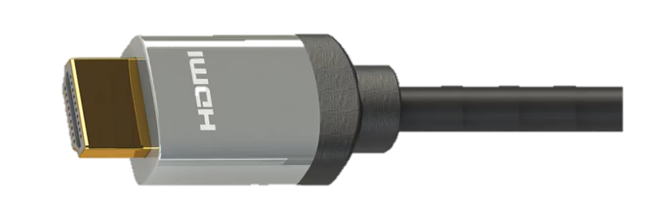
HDMI History
2017
2.1
2013
2.0
2006
2009
1.3
1.4
2004
1.0
4.5Gbps
1080i
10Gbps
Deep
Color
10Gbps
3D
4K30
18Gbps
4K60
48Gbps
10K
Dynamic HDR

Slide 4
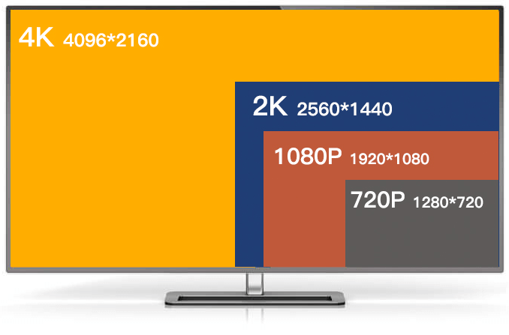
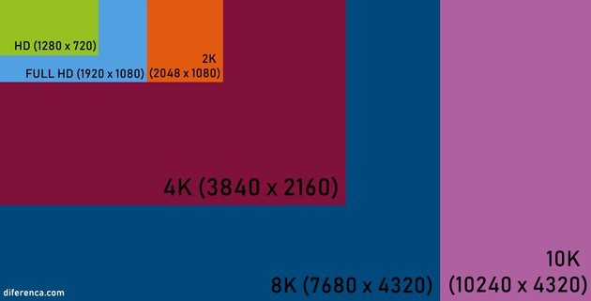
HDMI Resolution

Slide 5
HDMI Features
Features | HDMI Version
 | 1 | 1.1 | 1.2-1.2a | 1.3-1.3a | 1.4-1.4b | 2.0-2.0b | 2.1
Full HD Blu-ray Disc and HD DVD video | Yes | Yes | Yes | Yes | Yes | Yes | Yes
Consumer Electronic Control (CEC) | Yes | Yes | Yes | Yes | Yes | Yes | Yes
RGB | Yes | Yes | Yes | Yes | Yes | Yes | Yes
YCbCr 444 | Yes | Yes | Yes | Yes | Yes | Yes | Yes
YCbCr 422 | Yes | Yes | Yes | Yes | Yes | Yes | Yes
DVD-Audio | No | Yes | Yes | Yes | Yes | Yes | Yes
Super Audio CD (DSD) | No | No | Yes | Yes | Yes | Yes | Yes
Auto lip-sync | No | No | No | Yes | Yes | Yes | Yes
Dolby TrueHD / DTS-HD Master Audio bitstream capable | No | No | No | Yes | Yes | Yes | Yes
Updated list of CEC commands | No | No | No | Yes | Yes | Yes | Yes
3D Video | No | No | No | No | Yes | Yes | Yes
Ethernet channel (100Mbs) | No | No | No | No | Yes | Yes | Yes
Autdio return channel (ARC) | No | No | No | No | Yes | Yes | Yes
YCbCr 420 | No | No | No | No | No | Yes | Yes
4 Audio streams | No | No | No | No | No | Yes | Yes
2 Video streams (Dual View) | No | No | No | No | No | Yes | Yes
Hybrid Log-Gamma (HLG) HDR OETF | No | No | No | No | No | Yes | Yes
Static HDR (HDR static metadata) | No | No | No | No | No | Yes | Yes
Dynamic HDR (HDR dynamic metadata) | No | No | No | No | No | No | Yes
Enhanced Audio Return Channel (eARC) | No | No | No | No | No | No | Yes
Variable Refresh Rate (VRR) | No | No | No | No | No | No | Yes
Quick Frame Transport (QFT) (FVA) | No | No | No | No | No | No | Yes
Quick Media Switching (QMS) (VRR with M_CONST) | No | No | No | No | No | No | Yes
Auto Low Latency Mode (ALLM) | No | No | No | No | No | No | Yes
VESA DSC 1.2a | No | No | No | No | No | No | Yes
 | 1 | 1.1 | 1.2-1.2a | 1.3-1.3a | 1.4-1.4b | 2.0-2.0b | 2.1
Features | HDMI Version

Slide 6
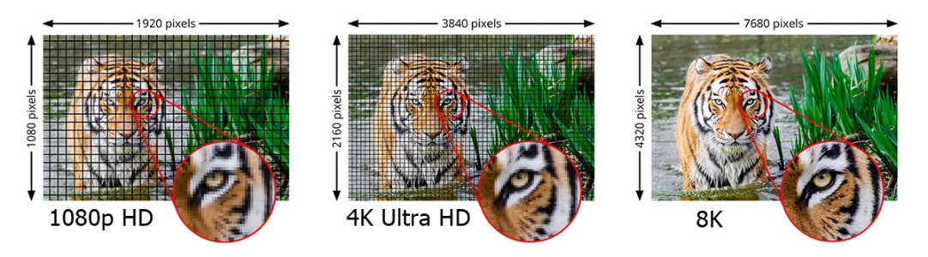
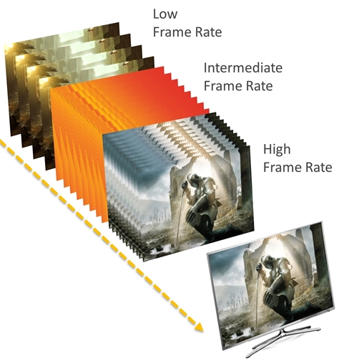
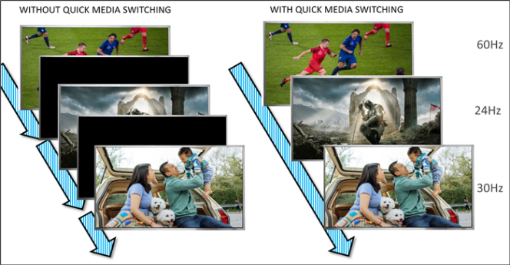
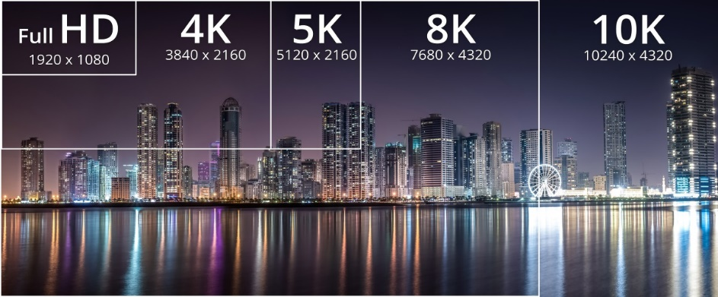
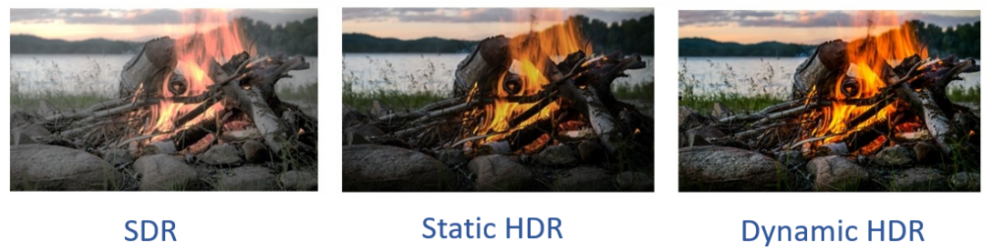
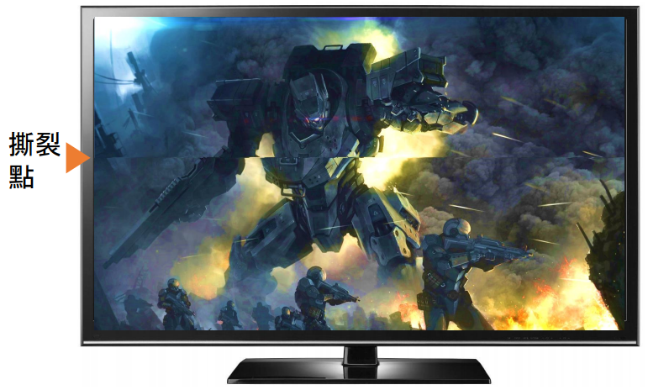
HDMI 2.1 Features
FVA
QMS
VRR

Slide 7
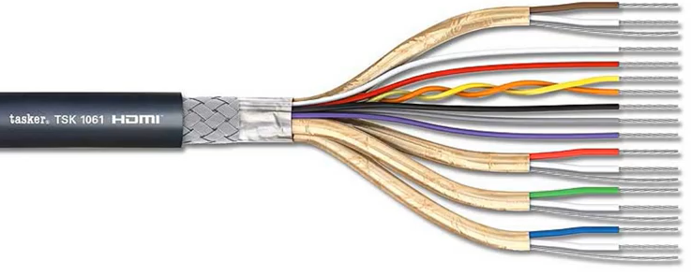
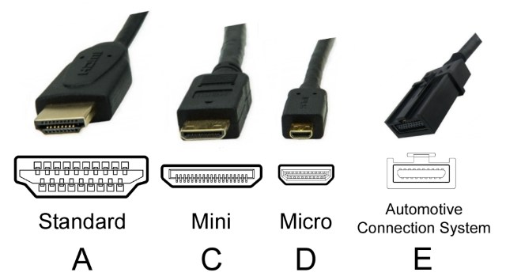
HDMI Interface
FRL Data 3 (TMDS Clock)
High Speed Lines
+5V & CEC
SCL & SDA
DDC/CE/HEC/HEAC Ground
Low Speed Lines
HPD
Utility/HEC/HEAC+ (Optional)
FRL Data 2 (TMDS Data 2)
FRL Data 1 (TMDS Data 1)
High Speed Lines
FRL Data 0 (TMDS Data 0)

Slide 8
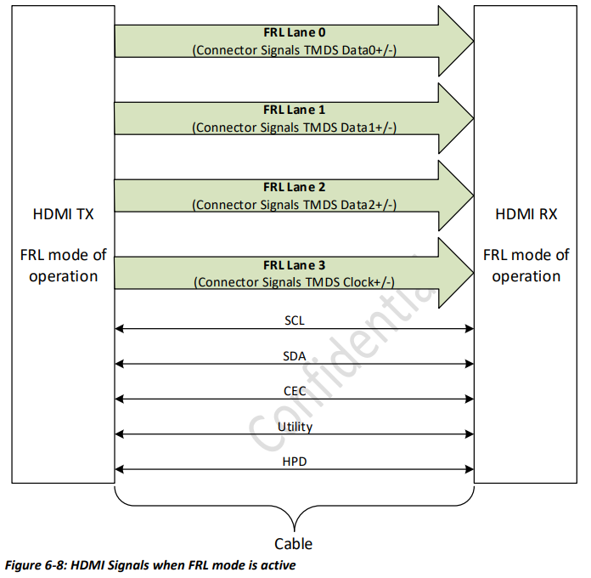
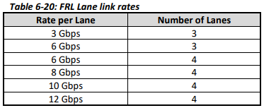
HDMI Interface
Channel | Data Type
TMDS/FRL | audio, video data and auxiliary data, including AVI and Audio InfoFrames
DDC | E-EDID SCDC data structure (sink capabilities and characteristics)
CEC | high-level user functions (automatic setup tasks or remote control usage)
Utility/HPD | bidirectional data channel
Fixed Rate Link (FRL): During the video data period, the pixels of an active video line are transmitted; and during the horizontal and vertical blanking intervals, audio and auxiliary data are transmitted within a series of packets. The control period occurs between video and data island periods.
Display Data Channel (DDC): enables the display to communicate its supported display modes and enable the host to adjust parameters such as brightness and contrast.
Consumer Electronics Control (CEC): allows the user to control up-to ten enabled devices connected through HDMI.
enhance Audio Return Channel (eARC): to replace other audio cables between for example the TV and a speaker system.
HDMI Ethernet Channel (HEC): provides a 100Mbit/s bi-directional link.
Hot-Plug-Detect (HPD): detect source sink connection.

Slide 9
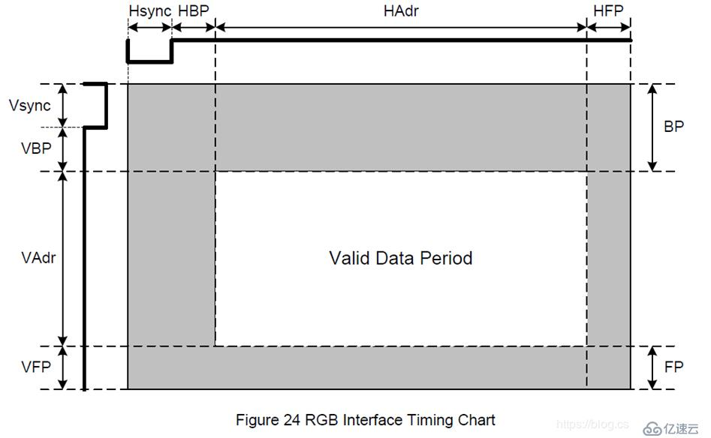
FRL Channel – Video Timing Diagram
Hactive
Audio data or Control data
Vactive
Video data (RGB/YCBCR)

Slide 10
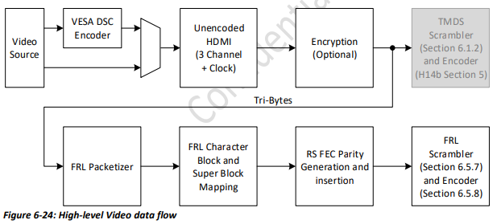
FRL Channel – FRL Data Flow
TMDS
Stream
FRL
Stream

Slide 11
FRL Channel – Source/Sink Data Flow
source/sink data
(8bit data)
de/encoder
(18bit data)
de/scrambler
(16bit scr data)
character and super block
RS parity
generation
de/insertion
FRL de/packetizer
(16bit data)
de/encryption HDCP
(not yet)
uncompressed
(VESA DSC de/encoder)
(not use)

Slide 12
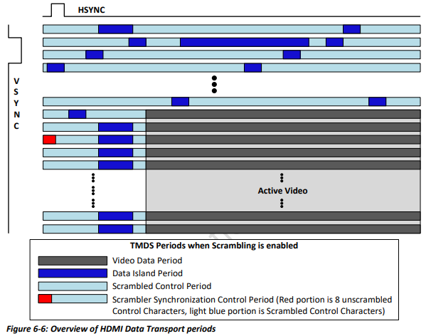
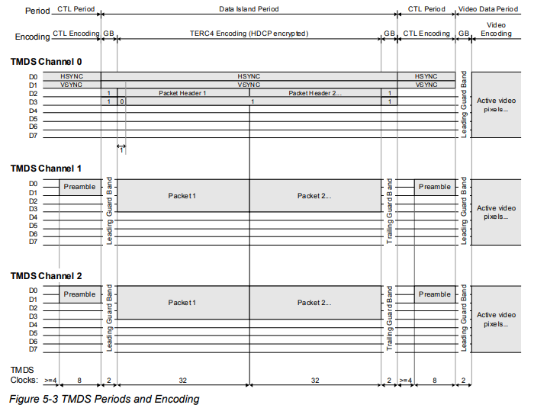
FRL Channel – Data Transmission

Slide 13
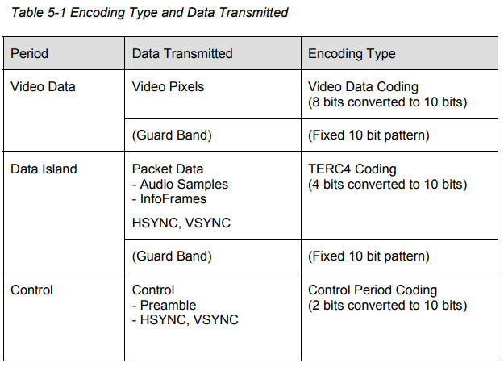
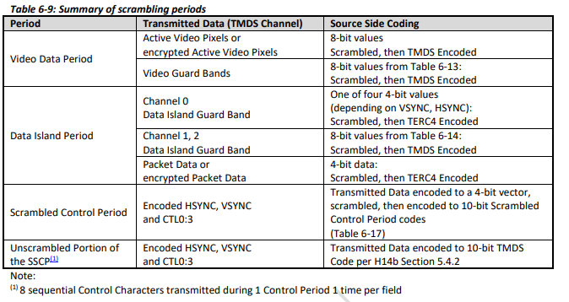
FRL Channel – Data Period
(TMDS)
(FRL)

Slide 14
FRL Channel – Source/Sink Data Flow
source/sink data
(8bit data)
de/encoder
(18bit data)
de/scrambler
(16bit scr data)
character and super block
RS parity
generation
de/insertion
FRL de/packetizer
(16bit data)
de/encryption HDCP
(not yet)
uncompressed
(VESA DSC de/encoder)
(not use)

Slide 15
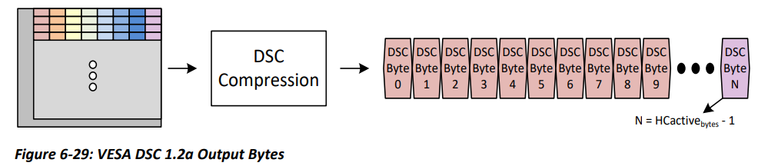
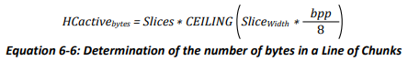
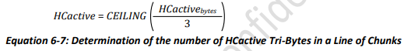
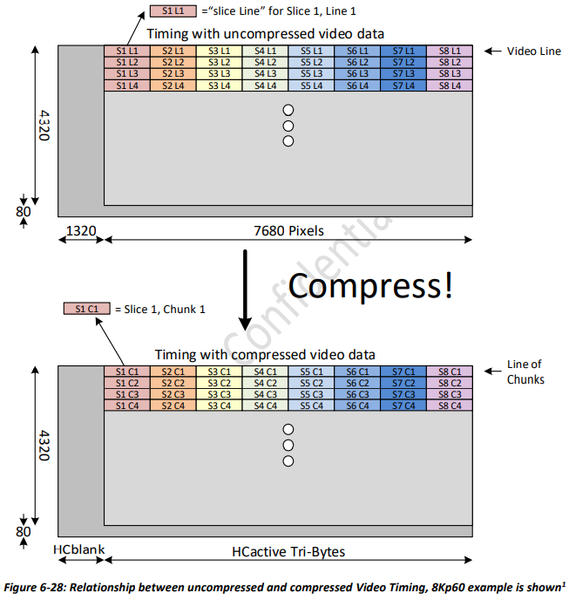
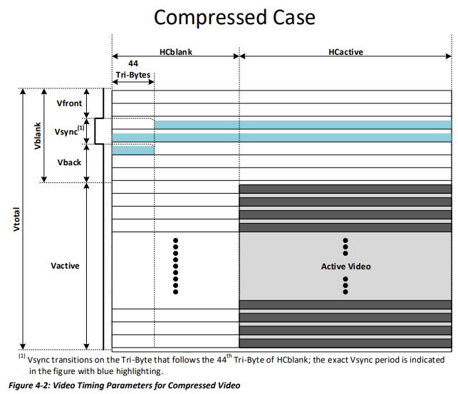
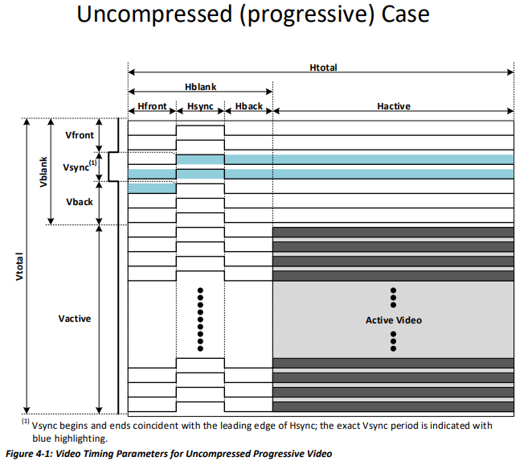

FRL Channel - VESA DSC Compression

Slide 16
FRL Channel – Source/Sink Data Flow
source/sink data
(8bit data)
de/encoder
(18bit data)
de/scrambler
(16bit scr data)
character and super block
RS parity
generation
de/insertion
FRL de/packetizer
(16bit data)
de/encryption HDCP
uncompressed
(VESA DSC de/encoder)
(not use)

Slide 17
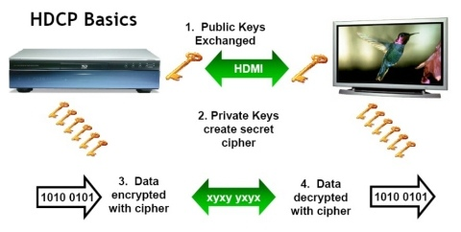
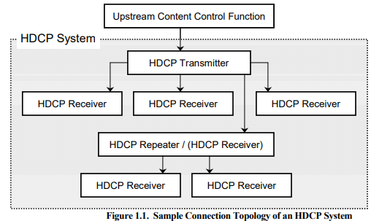
FRL Channel – HDCP Overview
High-Bandwidth Digital Content Protection 高頻寬數位內容保護
Authentication
Protocol
Encryption and Decryption
Renewability

Slide 18
FRL Channel – HDCP Version
HDMI Version | 1.0 | 1.1 | 1.2 | 1.3 | 1.4 | 2.0 | 2.1
HDCP Version | - | 1.2 | 1.2 | 1.2 | 1.4 | 2.2 | 2.2/2.3
Need HDCP 2.X – HDCP 1.X Converter

Slide 19
FRL Channel – HDCP 2.x Authentication Protocol
<HDCP Transmitter>
<HDCP Receiver>
<Transaction>
Hot Plug
Send EDID
Initiate HDCP Authentication : AKE_Init
Verify signature on certificate w/ Kpub-tx
< 100ms
AKE_Send_Certificate
Authentication and Key Exchange
(r_{tx}, receiver ID, RxCaps, TxCaps, Kpub_{rx}, k_{m}, E_{kpub}, r_{rx}, dkey₀, dkey₁, k_{d}, H, H’)
Generate master key Km; Encrypt w/ Kpub-rx
Write encrypted Km : AKE (No Km)
Decrypt Km w/ Kpriv Compute H-prime w/ RxCaps and TxCaps
Verify integrity of SRM Revocation check compute H-tx and verify H-tx w/ H-rx
< 1sec
Read H : AKE_Send_H_Prime
Read Ekh : AKE_Send_Pairing_Info
Compute Ekh using master key Km
Pairing
(E_{kh}, m)
Store m, Km and Ekh w/ Receiver ID
Set watchdog timer
Initiate Locality Check – LC_Init
Locality Check
(r_{n}, L, L’)
< 20ms
Compute L compare with L-prime
Read L-prime : LC_Send_L_Prime
Session Key Exchange
(k_{s}, r_{iv}, dkey₂, E_{dkey})
Generate session key Ks Compute Edkey
Send SKE : Eks
Decrypt session key verify Ks w/ Edkey

Slide 20
FRL Channel – HDCP 2.x Authentication Protocol
<HDCP Transmitter>
<HDCP Receiver>
<Transaction>
Hot Plug
Hot plug asserted from Receiver
Send EDID
Initiate HDCP Authentication : AKE_Init
Verify signature on certificate w/ Kpub-tx
< 100ms
AKE_Send_Certificate
Authentication and Key Exchange
(r_{tx}, receiver ID, RxCaps, TxCaps, Kpub_{rx}, k_{m}, E_{kpub}, r_{rx}, dkey₀, dkey₁, k_{d}, H, H’)
Generate master key Km; Encrypt w/ Kpub-rx
Write encrypted Km : AKE (No Km)
Decrypt Km w/ Kpriv Compute H-prime w/ RxCaps and TxCaps
Verify integrity of SRM Revocation check compute H-tx and verify H-tx w/ H-rx
< 1sec
Read H : AKE_Send_H_Prime
Read Ekh : AKE_Send_Pairing_Info
Compute Ekh using master key Km
Pairing
(E_{kh}, m)
Store m, Km and Ekh w/ Receiver ID
Set watchdog timer
Initiate Locality Check – LC_Init
Locality Check
(r_{n}, L, L’)
< 20ms
Compute L compare with L-prime
Read L-prime : LC_Send_L_Prime
Session Key Exchange
(k_{s}, r_{iv}, dkey₂, E_{dkey})
Generate session key Ks Compute Edkey
Send SKE : Eks
Decrypt session key verify Ks w/ Edkey

Slide 21
FRL Channel – HDCP 2.x Authentication Protocol
<HDCP Transmitter>
<HDCP Receiver>
<Transaction>
Hot Plug
Transmitter reads EDID from receiver
Send EDID
Initiate HDCP Authentication : AKE_Init
Verify signature on certificate w/ Kpub-tx
< 100ms
AKE_Send_Certificate
Authentication and Key Exchange
(r_{tx}, receiver ID, RxCaps, TxCaps, Kpub_{rx}, k_{m}, E_{kpub}, r_{rx}, dkey₀, dkey₁, k_{d}, H, H’)
Generate master key Km; Encrypt w/ Kpub-rx
Write encrypted Km : AKE (No Km)
Decrypt Km w/ Kpriv Compute H-prime w/ RxCaps and TxCaps
Verify integrity of SRM Revocation check compute H-tx and verify H-tx w/ H-rx
< 1sec
Read H : AKE_Send_H_Prime
Read Ekh : AKE_Send_Pairing_Info
Compute Ekh using master key Km
Pairing
(E_{kh}, m)
Store m, Km and Ekh w/ Receiver ID
Set watchdog timer
Initiate Locality Check – LC_Init
Locality Check
(r_{n}, L, L’)
< 20ms
Compute L compare with L-prime
Read L-prime : LC_Send_L_Prime
Session Key Exchange
(k_{s}, r_{iv}, dkey₂, E_{dkey})
Generate session key Ks Compute Edkey
Send SKE : Eks
Decrypt session key verify Ks w/ Edkey

Slide 22
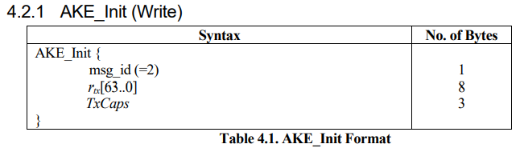
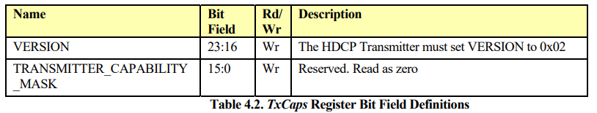
FRL Channel – HDCP 2.x Authentication Protocol
<HDCP Transmitter>
<HDCP Receiver>
<Transaction>
Hot Plug
Transmitter initiate authentication and key exchange :
Send r_{tx}, 64bits pseudo random number, later used in encryption of master key K_{m}
Send TxCap, 24bits transmitter HDCP capabilities
Send EDID
Initiate HDCP Authentication : AKE_Init
Verify signature on certificate w/ Kpub-tx
< 100ms
AKE_Send_Certificate
Authentication and Key Exchange
(r_{tx}, receiver ID, RxCaps, TxCaps, Kpub_{rx}, k_{m}, E_{kpub}, r_{rx}, dkey₀, dkey₁, k_{d}, H, H’)
Generate master key Km; Encrypt w/ Kpub-rx
Write encrypted Km : AKE (No Km)
Decrypt Km w/ Kpriv Compute H-prime w/ RxCaps and TxCaps
Verify integrity of SRM Revocation check compute H-tx and verify H-tx w/ H-rx
< 1sec
Read H : AKE_Send_H_Prime
Read Ekh : AKE_Send_Pairing_Info
Compute Ekh using master key Km
Pairing
(E_{kh}, m)
Store m, Km and Ekh w/ Receiver ID
Set watchdog timer
Initiate Locality Check – LC_Init
Locality Check
(r_{n}, L, L’)
< 20ms
Compute L compare with L-prime
Read L-prime : LC_Send_L_Prime
Session Key Exchange
(k_{s}, r_{iv}, dkey₂, E_{dkey})
Generate session key Ks Compute Edkey
Send SKE : Eks
Decrypt session key verify Ks w/ Edkey

Slide 23
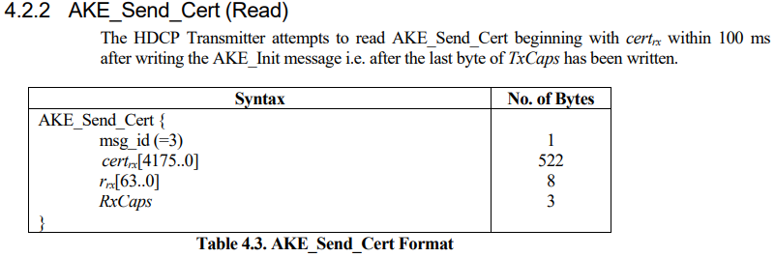
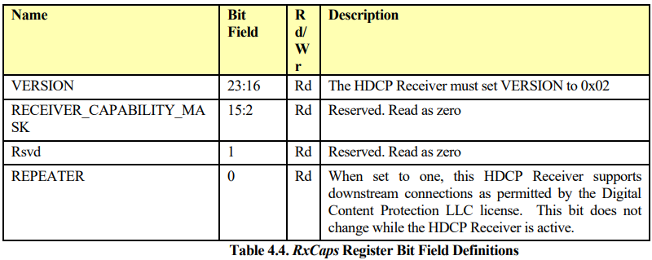
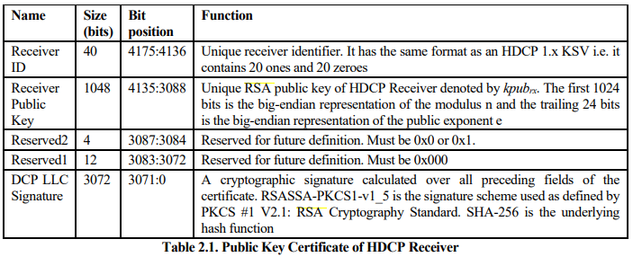
FRL Channel – HDCP 2.x Authentication Protocol
<HDCP Transmitter>
<HDCP Receiver>
<Transaction>
Hot Plug
Transmitter read receiver certificate :
Receiver ID
Receiver public key
DCP signature
Send EDID
Initiate HDCP Authentication : AKE_Init
Verify signature on certificate w/ Kpub-tx
< 100ms
AKE_Send_Certificate
Authentication and Key Exchange
(r_{tx}, receiver ID, RxCaps, TxCaps, Kpub_{rx}, k_{m}, E_{kpub}, r_{rx}, dkey₀, dkey₁, k_{d}, H, H’)
Generate master key Km; Encrypt w/ Kpub-rx
Write encrypted Km : AKE (No Km)
Decrypt Km w/ Kpriv Compute H-prime w/ RxCaps and TxCaps
Verify integrity of SRM Revocation check compute H-tx and verify H-tx w/ H-rx
< 1sec
Read H : AKE_Send_H_Prime
Read Ekh : AKE_Send_Pairing_Info
Compute Ekh using master key Km
Pairing
(E_{kh}, m)
Store m, Km and Ekh w/ Receiver ID
Set watchdog timer
Initiate Locality Check – LC_Init
Locality Check
(r_{n}, L, L’)
< 20ms
Compute L compare with L-prime
Read L-prime : LC_Send_L_Prime
Session Key Exchange
(k_{s}, r_{iv}, dkey₂, E_{dkey})
Generate session key Ks Compute Edkey
Send SKE : Eks
Decrypt session key verify Ks w/ Edkey

Slide 24
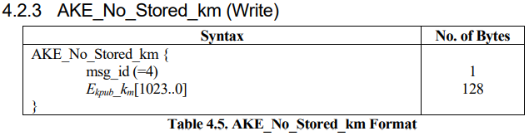
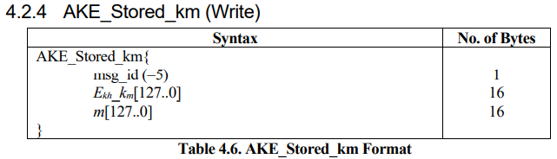
FRL Channel – HDCP 2.x Authentication Protocol
<HDCP Transmitter>
<HDCP Receiver>
<Transaction>
Hot Plug
Transmitter generate master key K_{m}, 128bytes pseudo random number, and encrypt K_{m} with kpub_{rx} (E_{kpub}(K_{m})), 1024bits to receiver
Send EDID
Initiate HDCP Authentication : AKE_Init
Verify signature on certificate w/ Kpub-tx
< 100ms
AKE_Send_Certificate
Authentication and Key Exchange
(r_{tx}, receiver ID, RxCaps, TxCaps, Kpub_{rx}, k_{m}, E_{kpub}, r_{rx}, dkey₀, dkey₁, k_{d}, H, H’)
Generate master key Km; Encrypt w/ Kpub-rx
Write encrypted Km : AKE (No Km)
Decrypt Km w/ Kpriv Compute H-prime w/ RxCaps and TxCaps
Verify integrity of SRM Revocation check compute H-tx and verify H-tx w/ H-rx
< 1sec
Read H : AKE_Send_H_Prime
Read Ekh : AKE_Send_Pairing_Info
Compute Ekh using master key Km
Pairing
(E_{kh}, m)
Store m, Km and Ekh w/ Receiver ID
Set watchdog timer
Initiate Locality Check – LC_Init
Locality Check
(r_{n}, L, L’)
< 20ms
Compute L compare with L-prime
Read L-prime : LC_Send_L_Prime
Session Key Exchange
(k_{s}, r_{iv}, dkey₂, E_{dkey})
Generate session key Ks Compute Edkey
Send SKE : Eks
Decrypt session key verify Ks w/ Edkey

Slide 25
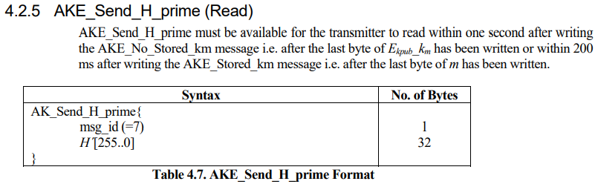
FRL Channel – HDCP 2.x Authentication Protocol
<HDCP Transmitter>
<HDCP Receiver>
<Transaction>
Hot Plug
Transmitter read Receiver‘s H-prime and verify master key K_{m}
Send EDID
Initiate HDCP Authentication : AKE_Init
Verify signature on certificate w/ Kpub-tx
< 100ms
AKE_Send_Certificate
Authentication and Key Exchange
(r_{tx}, receiver ID, RxCaps, TxCaps, Kpub_{rx}, k_{m}, E_{kpub}, r_{rx}, dkey₀, dkey₁, k_{d}, H, H’)
Generate master key Km; Encrypt w/ Kpub-rx
Write encrypted Km : AKE (No Km)
Decrypt Km w/ Kpriv Compute H-prime w/ RxCaps and TxCaps
Verify integrity of SRM Revocation check compute H-tx and verify H-tx w/ H-rx
< 1sec
Read H : AKE_Send_H_Prime
Read Ekh : AKE_Send_Pairing_Info
Compute Ekh using master key Km
Pairing
(E_{kh}, m)
Store m, Km and Ekh w/ Receiver ID
Set watchdog timer
Initiate Locality Check – LC_Init
Locality Check
(r_{n}, L, L’)
< 20ms
Compute L compare with L-prime
Read L-prime : LC_Send_L_Prime
Session Key Exchange
(k_{s}, r_{iv}, dkey₂, E_{dkey})
Generate session key Ks Compute Edkey
Send SKE : Eks
Decrypt session key verify Ks w/ Edkey

Slide 26
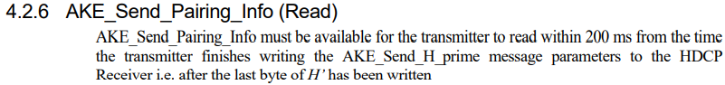
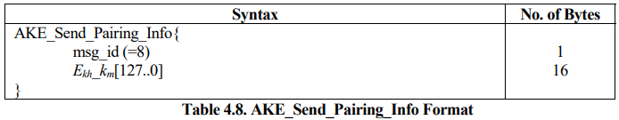
FRL Channel – HDCP 2.x Authentication Protocol
<HDCP Transmitter>
<HDCP Receiver>
<Transaction>
Hot Plug
Transmitter read Receiver‘s Ekh (K_{m}) AKE_Send_Pairing_Info
Send EDID
Initiate HDCP Authentication : AKE_Init
Verify signature on certificate w/ Kpub-tx
< 100ms
AKE_Send_Certificate
Authentication and Key Exchange
(r_{tx}, receiver ID, RxCaps, TxCaps, Kpub_{rx}, k_{m}, E_{kpub}, r_{rx}, dkey₀, dkey₁, k_{d}, H, H’)
Generate master key Km; Encrypt w/ Kpub-rx
Write encrypted Km : AKE (No Km)
Decrypt Km w/ Kpriv Compute H-prime w/ RxCaps and TxCaps
Verify integrity of SRM Revocation check compute H-tx and verify H-tx w/ H-rx
< 1sec
Read H : AKE_Send_H_Prime
Read Ekh : AKE_Send_Pairing_Info
Compute Ekh using master key Km
Pairing
(E_{kh}, m)
Store m, Km and Ekh w/ Receiver ID
Set watchdog timer
Initiate Locality Check – LC_Init
Locality Check
(r_{n}, L, L’)
< 20ms
Compute L compare with L-prime
Read L-prime : LC_Send_L_Prime
Session Key Exchange
(k_{s}, r_{iv}, dkey₂, E_{dkey})
Generate session key Ks Compute Edkey
Send SKE : Eks
Decrypt session key verify Ks w/ Edkey

Slide 27
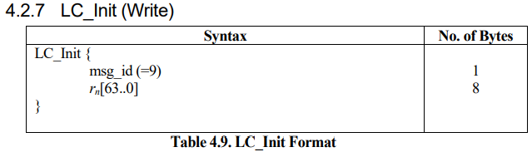
FRL Channel – HDCP 2.x Authentication Protocol
<HDCP Transmitter>
<HDCP Receiver>
<Transaction>
Hot Plug
Transmitter initiate Locality Check, set watchdog timer and send a random number r_{n} to Receiver
Send EDID
Initiate HDCP Authentication : AKE_Init
Verify signature on certificate w/ Kpub-tx
< 100ms
AKE_Send_Certificate
Authentication and Key Exchange
(r_{tx}, receiver ID, RxCaps, TxCaps, Kpub_{rx}, k_{m}, E_{kpub}, r_{rx}, dkey₀, dkey₁, k_{d}, H, H’)
Generate master key Km; Encrypt w/ Kpub-rx
Write encrypted Km : AKE (No Km)
Decrypt Km w/ Kpriv Compute H-prime w/ RxCaps and TxCaps
Verify integrity of SRM Revocation check compute H-tx and verify H-tx w/ H-rx
< 1sec
Read H : AKE_Send_H_Prime
Read Ekh : AKE_Send_Pairing_Info
Compute Ekh using master key Km
Pairing
(E_{kh}, m)
Store m, Km and Ekh w/ Receiver ID
Set watchdog timer
Initiate Locality Check – LC_Init
Locality Check
(r_{n}, L, L’)
< 20ms
Compute L compare with L-prime
Read L-prime : LC_Send_L_Prime
Session Key Exchange
(k_{s}, r_{iv}, dkey₂, E_{dkey})
Generate session key Ks Compute Edkey
Send SKE : Eks
Decrypt session key verify Ks w/ Edkey

Slide 28
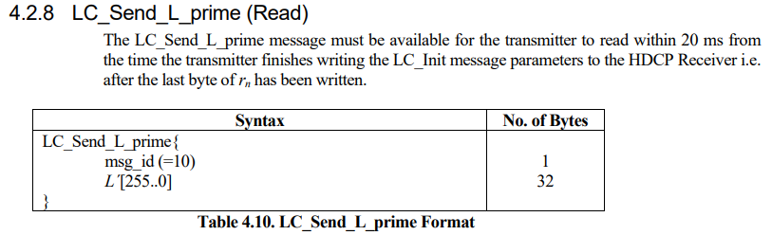
FRL Channel – HDCP 2.x Authentication Protocol
<HDCP Transmitter>
<HDCP Receiver>
<Transaction>
Hot Plug
Transmitter check for L-prime by comparing to L (256bit number) which are generated from Rn with Hash SHA-256
Send EDID
Initiate HDCP Authentication : AKE_Init
Verify signature on certificate w/ Kpub-tx
< 100ms
AKE_Send_Certificate
Authentication and Key Exchange
(r_{tx}, receiver ID, RxCaps, TxCaps, Kpub_{rx}, k_{m}, E_{kpub}, r_{rx}, dkey₀, dkey₁, k_{d}, H, H’)
Generate master key Km; Encrypt w/ Kpub-rx
Write encrypted Km : AKE (No Km)
Decrypt Km w/ Kpriv Compute H-prime w/ RxCaps and TxCaps
Verify integrity of SRM Revocation check compute H-tx and verify H-tx w/ H-rx
< 1sec
Read H : AKE_Send_H_Prime
Read Ekh : AKE_Send_Pairing_Info
Compute Ekh using master key Km
Pairing
(E_{kh}, m)
Store m, Km and Ekh w/ Receiver ID
Set watchdog timer
Initiate Locality Check – LC_Init
Locality Check
(r_{n}, L, L’)
< 20ms
Compute L compare with L-prime
Read L-prime : LC_Send_L_Prime
Session Key Exchange
(k_{s}, r_{iv}, dkey₂, E_{dkey})
Generate session key Ks Compute Edkey
Send SKE : Eks
Decrypt session key verify Ks w/ Edkey

Slide 29
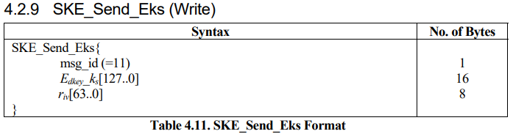
FRL Channel – HDCP 2.x Authentication Protocol
<HDCP Transmitter>
<HDCP Receiver>
<Transaction>
Hot Plug
Transmitter generate random session key K_{s} which is AES-encrypted using master key K_{m} and send session key K_{s} to receiver with a pseudo random number r_{iv} in SKE_Send_EKs
Send EDID
Initiate HDCP Authentication : AKE_Init
Verify signature on certificate w/ Kpub-tx
< 100ms
AKE_Send_Certificate
Authentication and Key Exchange
(r_{tx}, receiver ID, RxCaps, TxCaps, Kpub_{rx}, k_{m}, E_{kpub}, r_{rx}, dkey₀, dkey₁, k_{d}, H, H’)
Generate master key Km; Encrypt w/ Kpub-rx
Write encrypted Km : AKE (No Km)
Decrypt Km w/ Kpriv Compute H-prime w/ RxCaps and TxCaps
Verify integrity of SRM Revocation check compute H-tx and verify H-tx w/ H-rx
< 1sec
Read H : AKE_Send_H_Prime
Read Ekh : AKE_Send_Pairing_Info
Compute Ekh using master key Km
Pairing
(E_{kh}, m)
Store m, Km and Ekh w/ Receiver ID
Set watchdog timer
Initiate Locality Check – LC_Init
Locality Check
(r_{n}, L, L’)
< 20ms
Compute L compare with L-prime
Read L-prime : LC_Send_L_Prime
Session Key Exchange
(k_{s}, r_{iv}, dkey₂, E_{dkey})
Generate session key Ks Compute Edkey
Send SKE : Eks
Decrypt session key verify Ks w/ Edkey

Slide 30
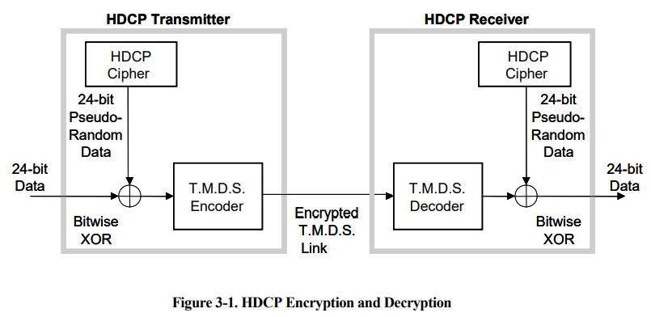
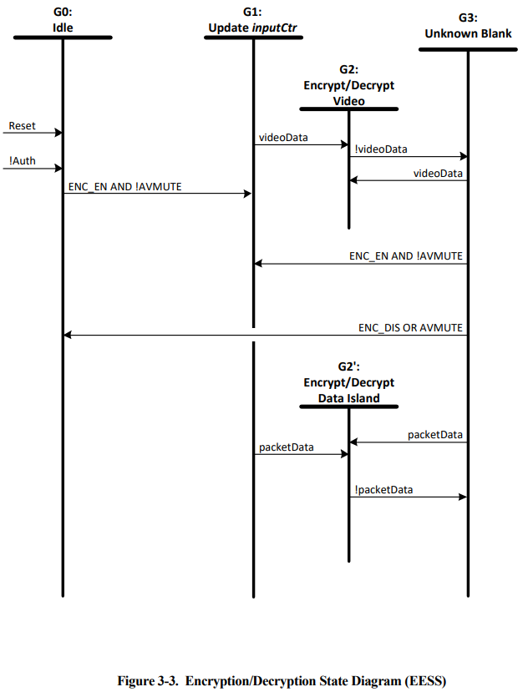
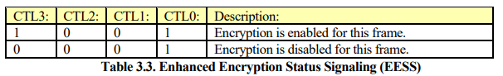
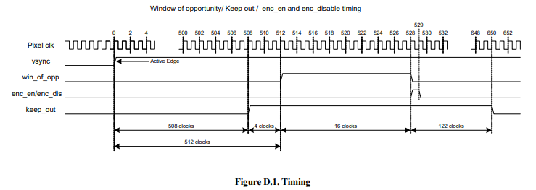
FRL Channel – HDCP Encryption / Decryption
FRL for HDMI 2.1
FRL for HDMI 2.1

Slide 31
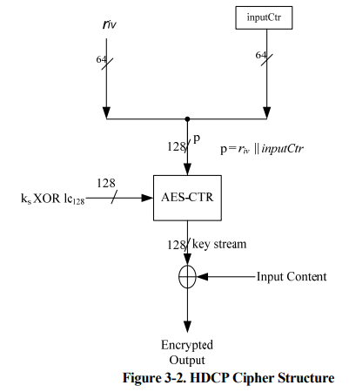
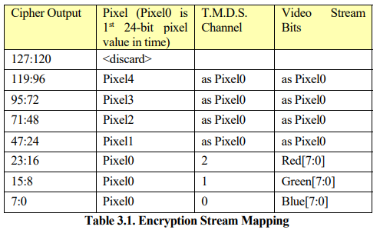
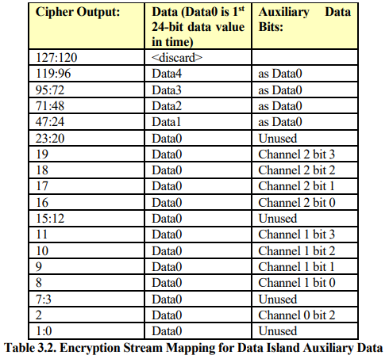
FRL Channel – HDCP Cipher
pseudo random number
inputCtr = FrameNumber || DataNumber
Source
常數

Slide 32
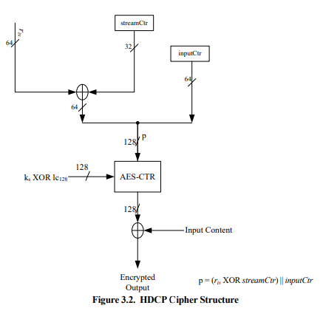
FRL Channel – HDCP Cipher 2.2 / 2.3
HDCP 2.2
HDCP 2.3

Slide 33
FRL Channel – HDCP Cipher
Encryption: SubBytes(), ShiftRows(), MixColumns, AddRoundKey()
Decryption: InvSubBytes(), InvShiftRows(), InvMixColumns, AddRoundKey()
AddRoundKey()
MixColumns()
ShiftRows()
SubBytes()
AddRoundKey()
InvMixColumns()
InvShiftRows()
InvSubBytes()

Slide 34
FRL Channel – HDCP Cipher
Encryption: SubBytes(), ShiftRows(), MixColumns, AddRoundKey()
Decryption: InvSubBytes(), InvShiftRows(), InvMixColumns, AddRoundKey()
AddRoundKey()
MixColumns()
ShiftRows()
SubBytes()
AddRoundKey()
InvMixColumns()
InvShiftRows()
InvSubBytes()

Slide 35
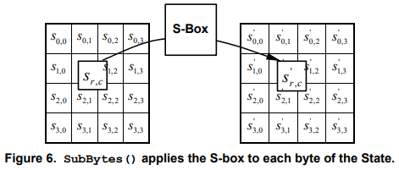


FRL Channel – Cipher SubBytes()/InvSubBytes()
SubBytes()
InvSubBytes()

Slide 36
FRL Channel – HDCP Cipher
Encryption: SubBytes(), ShiftRows(), MixColumns, AddRoundKey()
Decryption: InvSubBytes(), InvShiftRows(), InvMixColumns, AddRoundKey()
AddRoundKey()
MixColumns()
ShiftRows()
SubBytes()
AddRoundKey()
InvMixColumns()
InvShiftRows()
InvSubBytes()

Slide 37


FRL Channel – Cipher ShiftRows()/InvShiftRows()
ShiftRows()
InvShiftRows()

Slide 38
FRL Channel – HDCP Cipher
Encryption: SubBytes(), ShiftRows(), MixColumns, AddRoundKey()
Decryption: InvSubBytes(), InvShiftRows(), InvMixColumns, AddRoundKey()
AddRoundKey()
MixColumns()
ShiftRows()
SubBytes()
AddRoundKey()
InvMixColumns()
InvShiftRows()
InvSubBytes()

Slide 39







FRL Channel – Cipher MixColumns()/InvMixColumns()
MixColumns()
InvMixColumns()

Slide 40
FRL Channel – HDCP Cipher
Encryption: SubBytes(), ShiftRows(), MixColumns, AddRoundKey()
Decryption: InvSubBytes(), InvShiftRows(), InvMixColumns, AddRoundKey()
AddRoundKey()
MixColumns()
ShiftRows()
SubBytes()
AddRoundKey()
InvMixColumns()
InvShiftRows()
InvSubBytes()

Slide 41

FRL Channel – Cipher AddRoundKey()

Slide 42

FRL Channel – HDCP Cipher AES128 Flow
(128bits)
(128bits)
(128bits)

Slide 43

FRL Channel – HDCP Cipher AES128 Example
Encryption | Value
Data Input | 00112233445566778899aabbccddeeff
Data Output | 69c4e0d86a7b0430d8cdb78070b4c55a
Key Input | 000102030405060708090a0b0c0d0e0f
Key Output | 13111d7fe3944a17f307a78b4d2b30c5
Decryption | Value
Data Input | 69c4e0d86a7b0430d8cdb78070b4c55a
Data Output | 00112233445566778899aabbccddeeff
Key Input | 13111d7fe3944a17f307a78b4d2b30c5
Key Output | 000102030405060708090a0b0c0d0e0f

Slide 44



FRL Channel – HDCP Renewability
(System Renewability Message)

Slide 45

FRL Channel – HDCP 2.x Message Format
HDCP 2.2 only

Slide 46






FRL Channel – HDCP Port
HDCP use DDC Channel
for communication
I2C address = 0x74, 0x75 (read/write)

Slide 47
FRL Channel – Source/Sink Data Flow
source/sink data
(8bit data)
de/encoder
(18bit data)
de/scrambler
(16bit scr data)
character and super block
RS parity
generation
de/insertion
FRL de/packetizer
(16bit data)
de/encryption HDCP
(not yet)
uncompressed
(VESA DSC de/encoder)
(not use)

Slide 48



FRL Channel - Packetizer
0~1022 Data Characters

Slide 49

FRL Channel – Gap (Map Type = 1)
(Map Type = 1, Map Length = 1)
0100, 0000, 0000, 0001 = 0x401

Slide 50

FRL Channel – Video Data (Map Type = 2)
Active Video Data = 2 Guard Band Character + Pixel Data

Slide 51

FRL Channel – Video Blanking (Map Type = 3)

Slide 52


FRL Channel – TMDS 8b to FRL 16b Data

Slide 53
FRL Channel – Video Data 8b16b
video preamble
video guard band
video data
gap
MAP Type + Length = 0x08 + 0x0E

Slide 54




FRL Channel – Control and Data Island 8b16b
Control
Guard band
Data island
hsync = 0
vsync = 1
t0_d2 = 1
t0_d3 = 1
t1_d0 = 0
t1_d1 = 0
t1_d2 = 0
t1_d3 = 0
t2_d0 = 0
t2_d1 = 0
t2_d2 = 0
t2_d3 = 0
0x800e
hsync = 1
vsync = 1
rc(0) = 0
rc(1) = 1
rc(2) = 1
ctl0 = 1
ctl1 = 0
ctl2 = 1
ctl3 = 0
0x43b
hsync = 0
vsync = 1
rc(0) = 0
rc(1) = 0
rc(2) = 0
ctl0 = 1
ctl1 = 0
ctl2 = 1
ctl3 = 0
0x422
hsync = 0
vsync = 1
0xc20e
hsync = 0
vsync = 1
t0_d2 = 1
t0_d3 = 0
t1_d0 = 0
t1_d1 = 0
t1_d2 = 0
t1_d3 = 0
t2_d0 = 0
t2_d1 = 0
t2_d2 = 0
t2_d3 = 0
0x8006

Slide 55







FRL Channel – Zero Padding

Slide 56
FRL Channel – Source/Sink Data Flow
source/sink data
(8bit data)
de/encoder
(18bit data)
de/scrambler
(16bit scr data)
character and super block
RS parity
generation
de/insertion
FRL de/packetizer
(16bit data)
de/encryption HDCP
(not yet)
uncompressed
(VESA DSC de/encoder)
(not use)

Slide 57




FRL Channel – Reed Solomon Forward Error Correction

Slide 58


FRL Channel – RS Parity Data Mapping

Slide 59




FRL Channel – RS Parity Data Mapping Swap

Slide 60
FRL Channel – Source/Sink Data Flow
source/sink data
(8bit data)
de/encoder
(18bit data)
de/scrambler
(16bit scr data)
character and super block
RS parity
generation
de/insertion
FRL de/packetizer
(16bit data)
de/encryption HDCP
(not yet)
uncompressed
(VESA DSC de/encoder)
(not use)

Slide 61




FRL Channel – Character and Super Block
18'h3_011E
18'h0FEE1
18'h3_0117
18'h0FEE8

Slide 62

FRL Channel – Block Mapping (3 lane)

Slide 63




FRL Channel – Block Mapping (4 lane)

Slide 64
FRL Channel – Source/Sink Data Flow
source/sink data
(8bit data)
de/encoder
(18bit data)
de/scrambler
(16bit scr data)
character and super block
RS parity
generation
de/insertion
FRL de/packetizer
(16bit data)
de/encryption HDCP
(not yet)
uncompressed
(VESA DSC de/encoder)
(not use)

Slide 65





FRL Channel – LFSR Scrambler
Linear Feedback Shift Register 線性反饋位移暫存器
0xAB
0x55
0xab
0x55
0x55

Slide 66

FRL Channel – LFSR Scrambler
Lane0: | FBFE XOR FFFF = 401
 | 3AD3 XOR 3ED2 = 401
 | B9BA XOR BDBB = 401
 | 5B7E XOR 5F7F = 401
Lane1: | 7BFE XOR 7FFF = 401
 | BACF XOR BECE = 401
 | 181D XOR 1C1C = 401
 | 99A3 XOR 9DA2 = 401
Lane2: | BBFE XOR BFFF = 401
 | 7ADD XOR 7EDC = 401
 | 6975 XOR 6D74 = 401
 | BA0C XOR BE0D = 401
Lane3: | 3BFE XOR 3FFF = 401
 | FAC1 XOR FEC0 = 401
 | C8D2 XOR CCD3 = 401
 | 78D1 XOR 7CD0 = 401

Slide 67
FRL Channel – Source/Sink Data Flow
source/sink data
(8bit data)
de/encoder
(18bit data)
de/scrambler
(16bit scr data)
character and super block
RS parity
generation
de/insertion
FRL de/packetizer
(16bit data)
de/encryption HDCP
(not yet)
uncompressed
(VESA DSC de/encoder)
(not use)

Slide 68


FRL Channel – 16b18b Encoding
18'h3_011E1
18'h0FEE1
18'h3_0117
18'h0FEE8

Slide 69





FRL Channel – 16b18b Encoding
SSB
9b10b encoding
7b8b encoding

Slide 70
FRL Channel – Sink Data Flow Chart
start
lane_data_0/1/2/3
b18_group()
decoder_lane_18bit_data_0/1/2/3[17:0]
b18_2_16bscr()
decoder_lane_16bit_scr_data_0/1/2/3[15:0]
b16scr_2_16b()
decoder_lane_16bit_data_0/1/2/3[15:0]
b16_2_8b()
rs_fec_gen()
decoder_tmds_8bit_data_0/1/2/3[7:0]
rs_lane_data_0/1/2/3[15:0]
rs_compare()
rs_status_string_0/1/2/3[1023:0]
end

Slide 71
FRL Channel – Sink VIP
 |  |  |  |  | hdmi_sink_if |  | hdmi_sink_debug_if
 |  | CFG |  |  | input | output | output | transaction | sub functions
b18_group() |  | frl_en (1=enable frl; 0=disable frl) frl_lane (1=4 lane; 0=3 lane) |  |  | lane_data_0 lane_data_1 lane_data_2 lane_data_3 | decoder_lane_18bit_data_0[17:0] decoder_lane_18bit_data_1[17:0] decoder_lane_18bit_data_2[17:0] decoder_lane_18bit_data_3[17:0] | 18bit_block_lock comma_lock | NO NEED | find_sr_ssb(): searching for COMMA (SR (0x3011e, 0xfee1)/SSB (0x30117, 0xfee8)) collect_18bit(): After block locked, then keep collecting 18 bits data
b18_2_16bscr() |  | frl_en (1=enable frl; 0=disable frl) rfd (1=rfd+; 0=rfd-) |  |  | decoder_lane_18bit_data_0[17:0] decoder_lane_18bit_data_1[17:0] decoder_lane_18bit_data_2[17:0] decoder_lane_18bit_data_3[17:0] | decoder_lane_16bit_scr_data_0[15:0] decoder_lane_16bit_scr_data_1[15:0] decoder_lane_16bit_scr_data_2[15:0] decoder_lane_16bit_scr_data_3[15:0] | 16bit_block_lock comma_lock character_block_cnt[31:0] super_block_cnt[31:0] | NO NEED | find_sr_ssb(): search for COMMA (SR (0x3011e, 0xfee1)/SSB (0x30117, 0xfee8)) b10_2_9b(): transfer 10bit data into 9bit data b8_2_7b(): transfer 8bit data into 7bit data
b16scr_2_16b() |  | scrambling_enable (1=enable lfsr; 0=disable lfsr) |  |  | decoder_lane_16bit_scr_data_0[15:0] decoder_lane_16bit_scr_data_1[15:0] decoder_lane_16bit_scr_data_2[15:0] decoder_lane_16bit_scr_data_3[15:0] | decoder_lane_16bit_data_0[15:0] decoder_lane_16bit_data_1[15:0] decoder_lane_16bit_data_2[15:0] decoder_lane_16bit_data_3[15:0] | scramble_start | NO NEED | NO NEED
b16_2_8b() |  | NO NEED |  |  | decoder_lane_16bit_data_0[15:0] decoder_lane_16bit_data_1[15:0] decoder_lane_16bit_data_2[15:0] decoder_lane_16bit_data_3[15:0] | decoder_tmds_8bit_data_0[7:0] decoder_tmds_8bit_data_1[7:0] decoder_tmds_8bit_data_2[7:0] decoder_lane_rs_data_0[15:0] decoder_lane_rs_data_1[15:0] decoder_lane_rs_data_2[15:0] decoder_lane_rs_data_3[15:0] | 8bit_block_lock zero_padding data_period[1023:0] | NO NEED | is_video(): transfer 16bit data into 8bit data for video data is_other(): transfer 16bit data into 8bit data for control data or data island data
hdcp() |  | hdcp_en (1=enable hdcp; 0=disable hdcp) |  |  | decoder_tmds_8bit_data_0[7:0] decoder_tmds_8bit_data_1[7:0] decoder_tmds_8bit_data_2[7:0] | decoder_tmds_8bit_hdcp_data_0[7:0] decoder_tmds_8bit_hdcp_data_1[7:0] decoder_tmds_8bit_hdcp_data_2[7:0] | hdcp_status[1023:0] | NO NEED
rs_fec_gen() |  | rs_c_valid (1=reset RSCC; 0=remain) rscc (0~7fff=count rs) |  |  | decoder_lane_18bit_data_0[17:0] decoder_lane_18bit_data_1[17:0] decoder_lane_18bit_data_2[17:0] decoder_lane_18bit_data_3[17:0] | decoder_lane_rs_gen_0[15:0] decoder_lane_rs_gen_1[15:0] decoder_lane_rs_gen_2[15:0] decoder_lane_rs_gen_3[15:0] | rs_parity_lock | NO NEED | gf256_gen(): generate GF(2⁸) data
rs_compare() |  | NO NEED |  |  | decoder_lane_rs_gen_0[15:0] decoder_lane_rs_gen_1[15:0] decoder_lane_rs_gen_2[15:0] decoder_lane_rs_gen_3[15:0] | decoder_rs_status_string_0[1023:0] decoder_rs_status_string_1[1023:0] decoder_rs_status_string_2[1023:0] decoder_rs_status_string_3[1023:0] | NO NEED | NO NEED | NO NEED
i2c_data_info() |  | max_frl_rate, pixel_encoding color_depth video_format_type enable_debug_port enable_cec, custom_frame vfront_2_cust, vactive_cust vtotal_cust |  |  | sink_i2c_sda sink_i2c_sclk | sink_i2c_sda | current_state_status[1023:0] packet_cnt[31:0] | NO NEED | get_data(): get data information from DDC channel set_scdc(): set SCDC info for FRL parameters

Slide 72


FRL Channel – Link Training

Slide 73






FRL Channel – Link Training Pattern and Register

Slide 74



DDC Channel – Data Format
SCDC DDC Read/Write address = 0xA9, 0xA8
EDID DDC Read/Write address = 0xA1, 0xA0
0xA9
Read start from 0x10
Read multi bytes
0xA8

Slide 75



DDC Channel - Transaction
address write ack sub_address ack sr address read ack data not ack stop condition
(0x54) (0) (0) (0x40) (0) (0x54) (1) (0) (0x41) (1) (0)
1 0 1 0 1 0 0 0 0 0 1 0 0 0 0 0 0 0 1 1 0 1 0 1 0 0 1 0 0 1 0 0 0 0 0 1 1 0

Slide 76
DDC Channel – State Machine (Combinential)
WAIT_STOP
WAIT_ACK
ADDR_SUB
@(posedge sda)
if (sclk==1&stop==1)
if (is_ACK)
if (data_done)
next_st = ADDR_SUB
if (is_write)
if (addr_done)
if (addr_done)
@(negedge sda)
if (sclk)
if (repeat)
next_st = IDLE
next_st = COLLECT_D
next_st = WAIT_STOP
next_st = WAIT_ACK
next_st = ADDR
next_st = COLLECT_D
next_st = WRITE
next_st = COLLECT_D
next_st = WRITE
addr_cnt = 0
next_st = ACTION
addr_cnt = 0
next_st = ADDR

Slide 77
DDC Channel – State Machine (Sequential)
start
@(posedge sclk)
cur_st <= next_st
cur_st == IDLE
cur_st == ADDR
address <= this_bit
cur_st == ACTION
addr_cnt == 8
this_bit == 1
cur_st == WRITE
cur_st == COLLECT_D
cur_st != WAIT_ACK & next_st == WAIT_ACK
cur_st != WAIT_ACK & next_st == WAIT_ACK
// do nothing
addr_done <= 1
addr_done <= 0
is_write <= 1
subaddress <= this_bit
data <= this_bit
is_ack <=1
stop <=1
addr_cnt++
end

Slide 78





CEC Channel – Structure
每個block 10bits, 一個frame最多有16blocks, 每個block最後2bit為EOM及ACK
EOM = 0 代表後面還有Data block
EOM = 1 代表message complete
ACK = 0 代表裝置收到資料
ACK = 1 代表無回應或不動作

Slide 79



CEC Channel – Device Connectivity and Addressing
Physical Addressing
Logical Addressing
Address | Device
0 | TV
1 | Recording Device 1
2 | Recording Device 2
3 | Tuner 1
4 | Playback Device 1
5 | Audio System
6 | Tuner 2
7 | Tuner 3
8 | Playback Device 2
9 | Recording Device 3
10 | Tuner 4
11 | Playback Device 3
12 | Backup 1
13 | Backup 2
14 | Specific Use
15 | Unregistered

Slide 80

CEC Channel – 1.4 to 2.1

Slide 81
CEC Channel – End User Features
End User Features | Description | Messages
One Touch Play | allow a device to be played and become the active source with a single button press. | <Active Source>,<Image View On>,<Text View On>
System Standby | enable the user to switch all devices to Standby state with one button press. | <Standby>
One Touch Record | offer a What You See Is What You Record (WYSIWYR) facility, meaning whatever is shown on TV screen is recorded on a selected Recording Device. | <Record Off>,<Record On>,<Record Status>,<Record TV Screen>
Timer Programming | allow user to program timers in a Recording Device from an EPG running on TV or STB. | <Clear Analogue Timer>,<Clear Digital Timer>,<Clear External Timer>,<Set Analogue Timer>,<Set Digital Timer>,<Set External Timer>,<Set Timer Program Title>,<Timer Cleared Status>,<Timer Status>
Deck Control | enable a device to control and interrogate a Playback Device (deck) | <DeckStatus>,<GiveDeckStatus>,<DeckControl>,<Play>
Tuner Control | allow a device to control the tuner of another device | <GiveTunerDeviceStatus>,<RecordOn>,<SelectAnalogueService>,<SelectDigitalService>,<TunerStepDecrement>,<TunerStepIncrement>,<TunerDeviceStatus>
Device Menu Control | enable a device to control menu of another device by passing through user interface cmd | <User Control Pressed>,<User Control Released>,<Menu Request>,<Menu Status>
Remote Control Pass Through | enable remote control cmd to be passed through to other device within th system | <User Control Pressed>,<User Control Released>
System Audio Control | allow an audio amplifier/receiver to be used with TV. The volumen cam be controlled using any remote control of an suitably-equipped devices in system. | <GiveAudioStatus>,<GiveSystemAudioModeStatus>,<ReportAudioStatus>,<ReportShortAudioDescriptor>,<RequestShortAudioDescriptor>,<SetSystemAudioMode>,<SystemAudioModeRequest>,<SystemAudioModeStatus>,<UserControlPressed>,<UserControlReleased>

Slide 82
CEC Channel – Supporting Features
Supporting Features | Description | Messages
Device OSD Name Transfer | enable device to upload their preferred SOD name to TV | <Give OSD Name>,<Set OSD Name>
Device Power Status | allow current power status of a device to be discovered | <Give Device Power Status>,<Report Power Status>
OSD Display | enable a device to use the on-screen display of TV to display text strings | <Set OSD Display>
Routing Control | allow the control of CEC Switch for streaming of a new source device | <Active Source>,<Inactive Source>,<Request Active Source>,<Set Stream Path>,<Routing Change>,<Routing Information>
System Information | query the system to determine device address and language | <CEC Version>,<Get CEC Version>,<Get Menu Language>,<Give Physical Address>,<Polling Message>,<Report Physical Address>,<Set Menu Language>
Vendor Specific Commands | allow a set of vendor-defined cmd to be used between device of that vendor | <DeviceVendorID>,<GiveDeviceVendorID>,<VendorCmd>,<VendorCmdWithID>,<VendorRemoteButtonDown>,<VendorRemoteButtonUp>
Audio Rate Control | allow an Amplifier to fractionally de/increase playback rate of an audio source | <Set Audio Rate>
Audio Return Channel Control | control ARC part of HEAC | <Initiate ARC>,<Report ARC Initiated>,<Report ARC Terminated>,<Request ARC Initiation>,<Request ARC Termination>,<Terminate ARC>
Capability Discovery & Control | control HEC part of HEAC

Slide 83




eARC Channel – Overview

Slide 84



eARC Channel – Data Structure
(13 bits)

Slide 85


eARC Channel – Transaction

Slide 86



eARC Channel – Command and Data
(C/D = 1)
(C/D = 0)

Slide 87




eARC Channel – Read/Write Transaction

Slide 88



eARC Channel – Summary

Slide 89


VRR and FVA – Feature Introduction
Both FVA and VRR modify the Video Timing by increasing the number of lines in the vertical front porch. The number of lines for Vactive does not change. The timing of Vsync and Vback always remain the same. FVA_Factor is an integer value representing multiples of Vtotal. MVRR is an integer value representing additional lines.

Slide 90



VRR and FVA – Video Timing Extended Metadata
(packet type value = 0x7F)

Slide 91



Configuration – Data Island Packet

Slide 92


Configuration – EDID
Extended Display Identification Data 延伸辨識碼
DDC address = 0xA0, 0xA1
第一組128byte
第二組128byte
0x00FFFFFFFFFFFF00h

Slide 93



Configuration – EDID CEA Block Type
data block type
data length
=2
=1
=4
=3
=7

Slide 94









Configuration – SCDCS
Status and Control Data Channel Structure
DDC address = 0xA8, 0xA9

Slide 95
Configuration – SVT VIP (FRL)
SVT VIP Configuration | Value | Note
typedef enum { HDMI_VERSION_1_3, HDMI_VERSION_1_4, HDMI_VERSION_2_0, HDMI_VERSION_2_1} hdmi_protocol_specification_version_enum |  | HDMI version
typedef enum { RGB_4_4_4, YCBCR_4_4_4, YCBCR_4_2_2, YCBCR_4_2_0, PIXEL_ENC_IDO_DEFINED} pixel_encoding_enum |  | Pixel encoding technique
typedef enum { COLOR_DEPTH_24, COLOR_DEPTH_30, COLOR_DEPTH_36, COLOR_DEPTH_48} color_depth_enum |  | Deep color mode
typedef enum { FRAME_PACKING, FIELD_ALTERNATE, LINE_ALTERNATE, SIDE_BY_SIDE_FULL, L_DEPTH, L_DEPTH_GFX_GFXDEPTH, TOP_AND_BOTTOM, SIDE_BY_SIDE_HALF, FORMAT_2D, EXT_RESOLUTION_FORMAT} video_format_type_enum |  | Video format type
bit bypass_link_training | 1’b1 | Bypass link training process
rand bit [7:0] video_id_code | 1 | Determines video id codes which will be transmitted
rand bit cnmvrr | 1 | Sink support negative MVRR values when VRR and FVA are enabled
rand bit enable_hdcp | 1’b0 | Enable HDCP
rand bit enable_cec | 1’b0 | Enable CEC
rand bit enable_arc | 1’b0 | Enable ARC
rand bit earc | 1’b0 | Enable eARC
bit cust_frame |  | Frame need to be customized by providing all frame related parameters via configuration
int vfront_2_cust | -1 | Vertical lines for custom frame
int vactive_cust | -1 | Active video pixels per line for custom frame
Vtotal_cust | -1 | Total number lines in a frame for custom frame

Slide 96
Configuration – SVT VIP (HDCP)
SVT VIP Configuration | Value | Note
typedef enum { HDCP_VERSION_1_4, HDCP_VERSION_2_2, HDCP_VERSION_2_3} hdcp_protocol_version_enum |  | HDCP version
bit [39:0] bksv_hdcp_1_4 | 40’h511ef21acd | Update sink bksv value to source when a register bus is disabled
bit bypass_hdcp_key_exchange | 1’b0 | Bypass HDCP key exchange process and encryption of video and DI data will take place (HDCP 2.2)
bit bypass_hdcp_1_4_key_exchange | 1’b0 | Bypass HDCP key exchange process and encryption of video and DI data will take place (HDCP 1.4)
bit bypass_bus_in_hdcp_1_4_key_exchange | 1’b0 | Bypass DDC bus during HDCP key exchange process (HDCP 1.4)
bit [3071:0] hdcp_k_pub_dcp_modulus | 3072’hB0E9AA45F129BA0A1CBE175728EB2B4E8FD0C0….. | DCP LLC public key modulus (HDCP 2.2)
bit [3071:0] hdcp_rx_cert | 3072’h0640998f5a547123a76a643fbddd52b2796f8826….. | DCP LLC public key modulus (HDCP 2.2)
rand bit sink_is_repeater | 1’b0 | Configure sink to act as HDCP repeater
rand bit [3:0] rx_cert_reserved_value | 4’h1 | Reserved value defined in HDCP spec table 2.1
rand bit [127:0] hdcp_2_2_global_constand |  | 128bits global constant Ic128 (HDCP 2.2 and 2.3)
rand bit [127:0] session_key |  | 128bits pseudo random session key Ks (HDCP 2.2 and 2.3)
rand bit [55:0] session_key_hdcp_1_4 |  | 128bits pseudo random session key Ks (HDCP 1.4)
rand bit [63:0] riv |  | 64bits pseudo random number Riv (HDCP 2.2)
rand bit [63:0] hdcp_2_2_r_rx |  | Hold value of Rrx (HDCP 2.2)
rand bit [39:0] hdcp_2_2_rx_id |  | Hold value of receiver id (HDCP 2.2)
rand bit [1023:0] rsa_private_exponent |  | Hold private exponent for RSA encryption
rand bit [23:0] rsa_public_exponent |  | Hold public exponent for RSA encryption
rand bit [1023:0] rsa_public_key |  | Hold modulus for RSA encryption

Slide 97
Planning – Item Status
Item | Category | Description | Status
HDMI Specification | ALL | Presentation for HDMI 2.1 | Done
 | FRL | FRL to TMDS Data Flow Chart: a) Understand data flow chart from spec and waveform b) List data flow chart for source and sink | Done
 | DDC | DDC Channel (SDA/SCLK signal): a) I2C specification (HDMI2.1 10.4.3) b) Understand EDID and SCDC data structure c) SCLK SDA signal waveform clarification d) SCLK SDA signal FSM flow chart | Done
 | FRL/DDC | Waveform Analysis: a) Separate and category each signal of 'lane_data', 'decoder_lane_16bit_data', 'decoder_lane_18bit_data', 'sink_i2c_sda', 'sink_i2c_sclk', ...etc. b) Understand the data flow for each signals of waveform | Done
 | CEC | CEC Channel a) specification b) transaction | Done
 | HDCP | a) specification b) transaction flow chart understand | Done
Function | FRL | b18_group: implement task to group 18bits for input data with SV and verify the operation | Done
 | FRL | b16_2_8b: implement function to transfer 16bits to 8bits data with SV and verify the operation | Done
 | FRL | bit[15:0] b16scr_2_16b(ref bit[15:0] b16_scr, int cnt): understand and implement LFSR Scramble function with SV (16bits input and 16bits output) and verify operation | Done
 | FRL | bit [15:0] rs_fec_gen(ref bit[15:0] data_in): understand Reed-Solomon Forward Error Correction for FRL Operation and implement with SV and verify operation | Done
 | FRL | b18_2_16bscr: understand 16b18b encoding and decoding for FRL operation (HDMI 2.1 6.5.8 page 183) and implement with SV and verify the operation | Done
 | FRL | b10_2_9b: implement function to transfer 10bits data to 9bits data with SystemVerilog and verify the operation | Done
 | FRL | b8_2_7b: impement function to transfer 8bits data to 7bits data with SytemVerilog and verify the operation | Done
 | TMDS | TER4: implement function to encode tmds data with SystemVerilog and verify the operation | TBD
 | TMDS | parity_correct: understand Data Island Error Correction for Parity Byte (HDMI 1.4 5.2.3.5 page 84) and implement error correction with SV and verify operation | TBD
 | HDCP | AddRoundKey: implement function to transform a round key added by a simple bitwise XOR. | Done
 | HDCP | SubBytes and InvSubBytes: implement function to sub bytes data | Done
 | HDCP | ShiftRows and InvShiftRows: implement function to shift bytes data | Done
 | HDCP | MixColumns and InvMixColumns: implement function to do modulus and XOR with GF256 module | Done
 | HDCP | Encryption and Decryption: implement function to do encrypt and decrypt | Done
 | DDC | i2c_data_info: implement function to decode sda/sclk signal | TBD
Status | FRL | frl_state_enum {LTS1, LTS2, LTS3, LTS4, LTSP, LTSL} | Delete
 | FRL | frl_cur_state | Delete
 | FRL | frl_next_state | Delete

Slide 98
Planning – Item Status
Item | Category | Description | Status
Configuration (rt_vip_hdmi_configuration.sv) | FRL | max_frl_rate: 0 = disable FRL; 1 = FRL at 3 Gbps per Lane on 3 Lanes; 2 = FRL at 6 Gbps per Lane on 3 Lanes; 3 = FRL at 6 Gbps per Lane on 4 Lanes; 4 = FRL at 8 Gbps per Lane on 4 Lanes; 5 = FRL at 10 Gbps per Lane on 4 Lanes; 6 = FRL at 12 Gbps per Lane on 4 Lanes; 7-15 = Reversed. | Done
 | FRL | frl_en: 0 = disable FRL, 1 = enable FRL | Delete
 | FRL | frl_start: 0 = sink is not ready to receive video; 1 = link training is successful and sink is ready to receive video. | Delete
 | FRL | ffe_levels: source shall set to indicate maximum TxFFE level supported for the current FRL Rate. | Delete
 | FRL | scrambling_enable: source enable scrambling; 0 = disable scrambling, 1 = enable scrambling | Delete
 | FRL | tmds_scrambler_status: sink shall clear TMDS_Scrambler_Status = 0 anytime that Scrambling_Enable = 0 and apply scrambling when TMDS_Scrambler_Status = 1. | TBD
 | FRL | video_format_type: FRAME_PACKING, FIELD_ALTERNATE, LINE_ALTERNATE, SIDE_BY_SIDE_FULL, L_DEPTH, L_DEPTH_GFX_GFXDEPTH, TOP_AND_BOTTOM, SIDE_BY_SIDE_HALF, FORMAT_2D, EXT_RESOLUTION_FORMAT | Done
 | FRL | color_depth: COLOR_DEPTH_24, CORLO_DEPTH_30, COLOR_DEPTH_36, COLOR_DEPTH_48 | Done
 | FRL | pixel_encoding: RGB_4_4_4, YCBCR_4_4_4, YCBCR_4_2_2, YCBCR_4_2_0, PIXEL_ENC_IDO_DEFINED | Done
 | FRL | video_id_code: determine the video id codes which will be transmitted. | Done
 | DDC | rr_enable: sink shall reset this bit when SCDC of sink goes from the disabled to the enabled state. | TBD
 | HDCP | bit [39:0] bksv_hdcp_1_4 = 40’h511ef21acd: Update bksv value to source when a register bus is disabled | Done
 | HDCP | bit bypass_hdcp_key_exchange =1’b0: Bypass HDCP key exchange process and encryption of video and DI data will take place (HDCP 2.2) | Done
 | HDCP | bit bypass_hdcp_1_4_key_exchange = 1’b0: Bypass HDCP key exchange process and encryption of video and DI data will take place (HDCP 1.4) | Done
 | HDCP | bit bypass_bus_in_hdcp_1_4_key_exchange 1’b0: Bypass DDC during HDCP key exchange process (HDCP 1.4) | Done
 | HDCP | bit [3071:0] hdcp_k_pub_dcp_modulus = 3072’hB0E9AA45F12…: DCP LLC public key modulus (HDCP 2.2) | Done
Interface (rt_hdmi_if.sv) | FRL | frl_rate_1 = 4'h1 | Done
 | FRL | frl_rate_2 = 4'h2 | Done
 | FRL | frl_rate_3 = 4'h3 | Done
 | FRL | frl_rate_4 = 4'h4 | Done
 | FRL | frl_rate_5 = 4'h5 | Done
 | FRL | frl_rate_6 = 4'h6 | Done
 | FRL | lane_data_0: raw data from source for lane 0 | Done
 | FRL | lane_data_1: raw data from source for lane 1 | Done
 | FRL | lane_data_2: raw data from source for lane 2 | Done
 | FRL | lane_data_3: raw data from source for lane 3 | Done
 | FRL | decoder_lane_18bit_data_0[17:0]: decode raw data to 18bits data for lane 0 | Done
 | FRL | decoder_lane_18bit_data_1[17:0]: decode raw data to 18bits data for lane 1 | Done
 | FRL | decoder_lane_18bit_data_2[17:0]: decode raw data to 18bits data for lane 2 | Done
 | FRL | decoder_lane_18bit_data_3[17:0]: decode raw data to 18bits data for lane 3 | Done
 | FRL | decoder_lane_16bit_scr_data_0[15:0]: decode 18bits data to 16bits scramble data for lane 0 | Done
 | FRL | decoder_lane_16bit_scr_data_1[15:0]: decode 18bits data to 16bits scramble data for lane 1 | Done

Slide 99
Planning – Item Status
Item | Category | Description | Status
Interface (rt_hdmi_if.sv) | FRL | decoder_lane_16bit_scr_data_2[15:0]: decode 18bits data to 16bits scramble data for lane 2 | Done
 | FRL | decoder_lane_16bit_scr_data_3[15:0]: decode 18bits data to 16bits scramble data for lane 3 | Done
 | FRL | decoder_lane_16bit_data_0[15:0]: decode 16bits scramble data to 16bits data for lane 0 | Done
 | FRL | decoder_lane_16bit_data_1[15:0]: decode 16bits scramble data to 16bits data for lane 1 | Done
 | FRL | decoder_lane_16bit_data_2[15:0]: decode 16bits scramble data to 16bits data for lane 2 | Done
 | FRL | decoder_lane_16bit_data_3[15:0]: decode 16bits scramble data to 16bits data for lane 3 | Done
 | FRL | decoder_tmds_8bit_data_0[7:0]: decode 16bits data to 8bits TMDS data for lane 0 | Done
 | FRL | decoder_tmds_8bit_data_1[7:0]: decode 16bits data to 8bits TMDS data for lane 1 | Done
 | FRL | decoder_tmds_8bit_data_2[7:0]: decode 16bits data to 8bits TMDS data for lane 2 | Done
 | FRL | decoder_lane_rs_data_0[15:0]: 16bits reed-solomon parity for lane 0 | Done
 | FRL | decoder_lane_rs_data_1[15:0]: 16bits reed-solomon parity for lane 1 | Done
 | FRL | decoder_lane_rs_data_2[15:0]: 16bits reed-solomon parity for lane 2 | Done
 | FRL | decoder_lane_rs_data_3[15:0]: 16bits reed-solomon parity for lane 3 | Done
 | FRL | decoder_rs_status_string_0[15:0]: 16bits reed-solomon parity status for lane 0 | Done
 | FRL | decoder_rs_status_string_1[15:0]: 16bits reed-solomon parity status for lane 1 | Done
 | FRL | decoder_rs_status_string_2[15:0]: 16bits reed-solomon parity status for lane 2 | Done
 | FRL | decoder_rs_status_string_3[15:0]: 16bits reed-solomon parity status for lane 3 | Done
 | FRL | local_clk_18_sink_lane_0 | Done
 | FRL | local_clk_18_sink_lane_1 | Done
 | FRL | local_clk_18_sink_lane_2 | Done
 | FRL | local_clk_18_sink_lane_3 | Done
 | FRL | b18_lock_0 | Done
 | FRL | b18_lock_1 | Done
 | FRL | b18_lock_2 | Done
 | FRL | b18_lock_3 | Done
 | FRL | comma_lock | Done
 | FRL | b16_lock_0 | Done
 | FRL | b16_lock_1 | Done
 | FRL | b16_lock_2 | Done
 | FRL | b16_lock_3 | Done
 | FRL | b8_lock_0 | Done
 | FRL | b8_lock_1 | Done
 | FRL | b8_lock_2 | Done
 | FRL | character_block_cnt[31:0] | Done
 | FRL | super_block_cnt[31:0] | Done
 | FRL | scramble_start | Done
 | FRL | zero_padding | Done
 | FRL | frl_data_period | Done
 | FRL | rs_parity_lock | Done
 | DDC | i2c_cur_state | Done
 | DDC | i2c_packet_cnt[31:0] | Done

Slide 100
Planning – HDMI 2.1 VIP Files
rt_hdmi_checks.sv
rt_hdmi_command_checks.sv
rt_hdmi_command_coverages.sv
rt_hdmi_command_debug_ports.sv
rt_hdmi_command_traces.sv
rt_hdmi_common_pools.sv
rt_hdmi_common_update_component.sv
rt_hdmi_coverages.sv
rt_hdmi_if.sv
rt_hdmi_debug_ports.sv
rt_hdmi_debug_if.sv
rt_hdmi_monitor.sv
rt_hdmi_frl_xactor.sv
rt_hdmi_hdcp_xactor.sv
rt_hdmi_ddc_xactor.sv
rt_hdmi_service.sv
rt_hdmi_service_driver.sv
rt_hdmi_service_sequencer.sv
rt_hdmi_status.sv
rt_hdmi_traces.sv
rt_hdmi_transaction.sv
rt_hdmi_transaction_callbacks.sv
rt_hdmi_transaction_driver.sv
rt_hdmi_transaction_exception.sv
rt_hdmi_transaction_sequencer.sv
rt_hdmi_vip_agent.sv
rt_hdmi_virtual_sequencer.sv
rt_vip_hdmi_configuration.sv

Slide 101
Feedback – List
Group | Item | Owner | Status
HDMI 2.1 Sink VIP implementation | Implement HDCP 2.3 decryption | Joanna | Ongoing
 | List debug ports for FRL verification | DD/CM | Ongoing
 | Implement clock recovery from FRL data bit stream | Ming | Done
HDMI 2.1 check and coverage list enhanced features | List the checks and coverages | Joanna | Ongoing
 | List what DUT verification needs | DD/CM | Ongoing
 | Extract the related check and coverage lists from SNPS HDMI VIP manual | Ming | Done
Further HDMI 2.1 specification presentation | 6.5.6 FRL data flow metering and see how to provide this check support in VIP | Joanna | Done
Future support after HDMI 2.1 Sink adapter VIP | HDMI 2.0 RX model support | Joanna | TBD
 | CEC channel support | Joanna | TBD

Slide 102




Feedback – FRL Data Flow Metering

Slide 103



Feedback – FRL Data Flow Metering

Slide 104

Feedback – FRL Data Flow Metering (Uncompressed Video)

Slide 105




Feedback – FRL Data Flow Metering (Compressed Video)
(High FRL rate)
(High FRL rate)

Slide 106

Feedback – FRL Data Flow Metering Computation
Both compressed and uncompressed video

Slide 107
Feedback – Check and Coverage

Slide 108
Thank you.

Slide 109

LFSR Scrambler Example Code

Slide 110

16b18b Encoding Example Code

Slide 111


RS Parity Example Code

